Slide 1
Test Automation Patterns
Lecturer: Ngo Huy Bien
Software Engineering Department
Faculty of Information Technology
VNUHCM - University of Science
Ho Chi Minh City, Vietnam
nhbien@fit.hcmus.edu.vn

Slide 2

Objectives

Slide 3

Contents

Slide 4

References

Slide 5
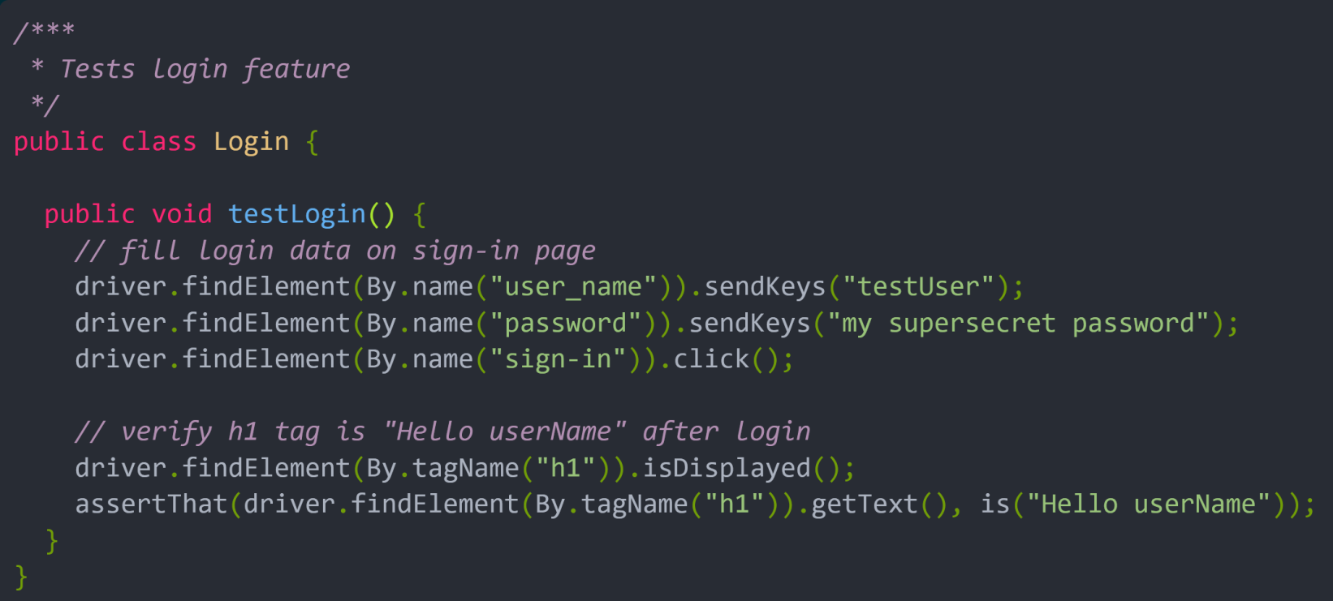
Typical of Test Automation
https://www.selenium.dev/documentation/en/guidelines_and_recommendations/page_object_models/

Slide 6
Problems
There is no separation between the test method and the AUT’s locators (IDs in this example); both are intertwined in a single method.
If the AUT’s UI changes its identifiers, layout, or how a login is input and processed, the test itself must change.

Slide 7
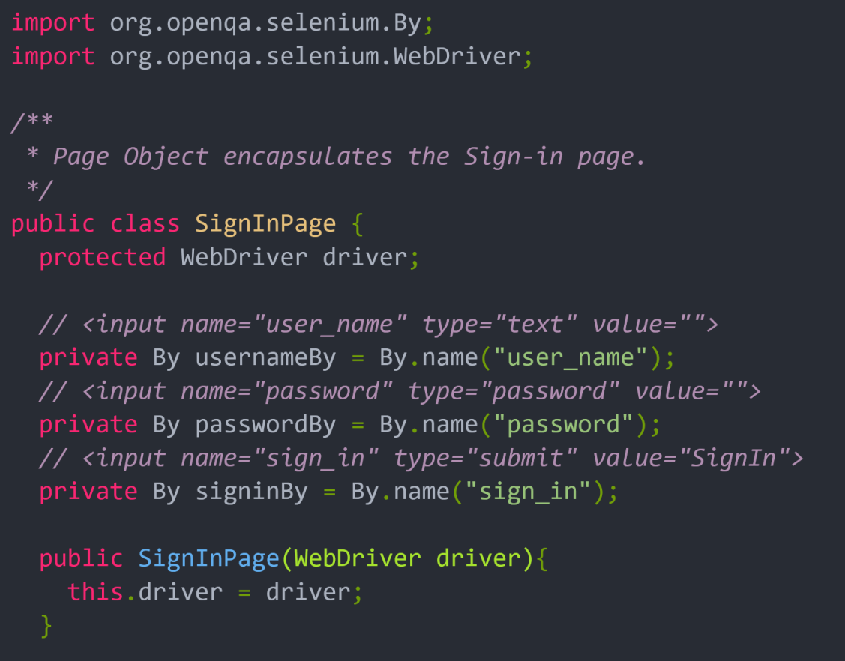
Page Object Technique (I)
Create a wrapper (adapter) for portion of HTML tags.
Inject WebDriver to the wrapper.

Slide 8
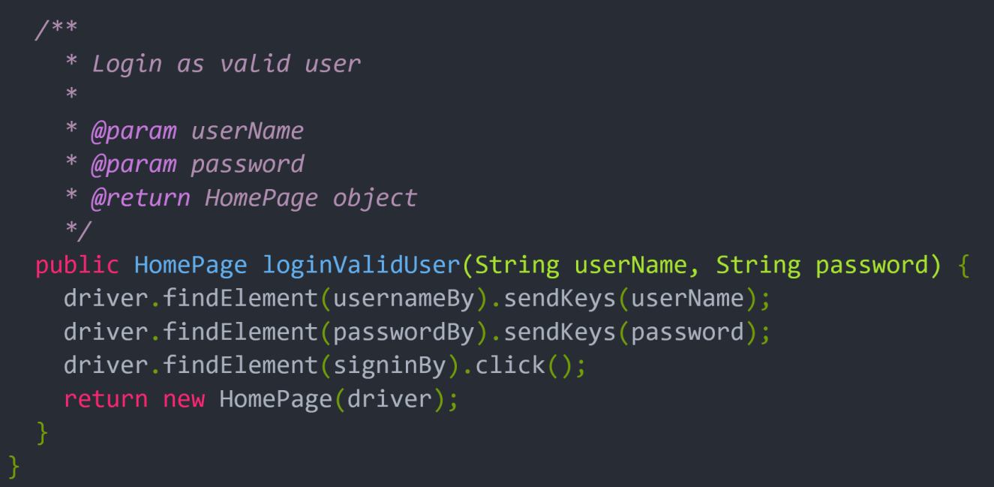
Page Object Technique (II)
Provide interfaces (functions) for testing.
Possibly refer to other wrappers (adapters/page objects).

Slide 9
Page Objects Summary
https://github.com/SeleniumHQ/selenium/wiki/PageObjects
The public methods represent the services that the page offers
Try not to expose the internals of the page
Generally don't make assertions
Methods return other PageObjects
Need not represent an entire page
Different results for the same action are modelled as different methods

Slide 10
Page Objects Code Smell
https://ideas.riverglide.com/page-objects-refactored-12ec3541990
The most common code-smell we see in PageObjects is ‘Large Class’.
One approach to this is to think of each PageObject not as an object representing a page but as objects within a page.
This means thinking of each object like a widget or page component. Even still, if a component has more than a couple of fields and buttons (as with the LoginPage example) the PageObject can still grow well beyond the 50–60 lines mark.

Slide 11
Page Objects & SRP
PageObjects commonly have the following responsibilities:
Provide an abstraction to the location of elements on a page via a meaningful label for what those elements mean in business terms.
Describe the tasks that can be completed on a page using its elements (often, but not always, expressing navigation in the PageObject returned by a task).
As these responsibilities are in a single class, when the way we locate a specific element is altered this class requires change. If the sequence of interactions required to complete a task change, again so must this class.
There we have more than one reason for change — violating the Single Responsibility Principle (SRP).

Slide 12
Page Objects & OCP
To satisfy the SRP, a naive approach might be to extract a class for each obvious responsibility, such as locating elements and performing tasks.
While this satisfies the SRP it does not satisfy the OCP (each new task requires editing the Tasks class).
To satisfy the OCP, a naive approach would be to extract classes into smaller PageObjects where adding a new behaviour would involve adding a new class.
While this satisfies the OCP in this example, it does not satisfy the SRP. In each of the above classes the two responsibilities of a) how to find the elements; and b) how to complete a given task; are still grouped together.

Slide 13
Page Objects Refactored
Instead of the above, a less naive approach would be to combine the Extract Class refactoring with the Replace Method with Method Object refactoring.

Slide 14


Slide 15
Boa Constrictor
https://q2ebanking.github.io/boa-constrictor/
Boa Constrictor is a C# implementation of the Screenplay Pattern.
Its primary use case is Web UI and REST API test automation.
Boa Constrictor helps you make better interactions for better automation!

Slide 16
Tutorial
https://q2ebanking.github.io/boa-constrictor/tutorial/overview/

Slide 17
Screenplay Pattern
https://q2ebanking.github.io/boa-constrictor/tutorial/overview/

Slide 18

Thank You & See You Again

